Slide 1
Python Introduction &
Linear Algebra Review
Kuan Fang
CS 231A
1/12/2018

Slide 2
Outline
Python Introduction
Linear Algebra Review + NumPy

Slide 3
Python Review

Slide 4

Python
High-level, interpreted programming language
You should already be proficient in programming
Being proficient with Python is a plus, but not strictly necessary
We’ll cover some basics today

Slide 5
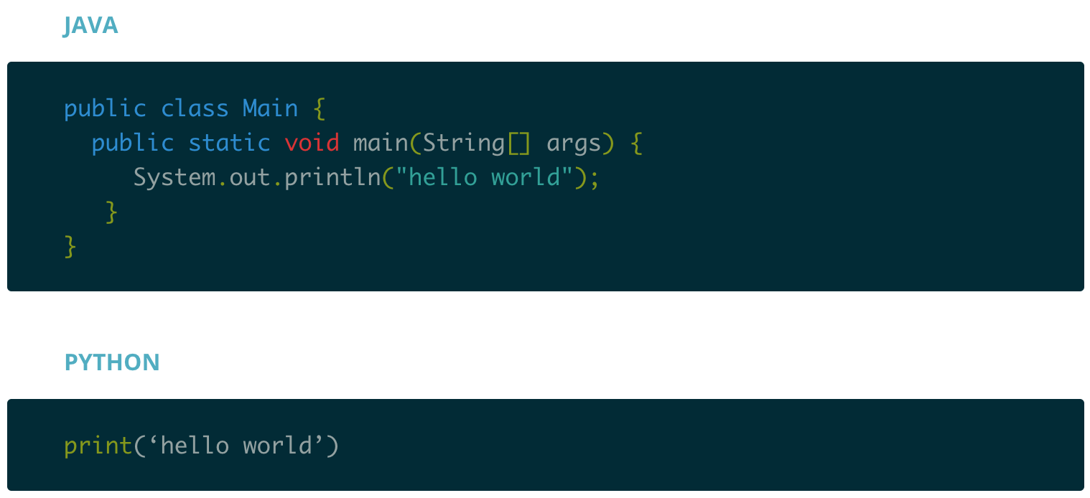
Why Python?
Python is high-level.

Slide 6
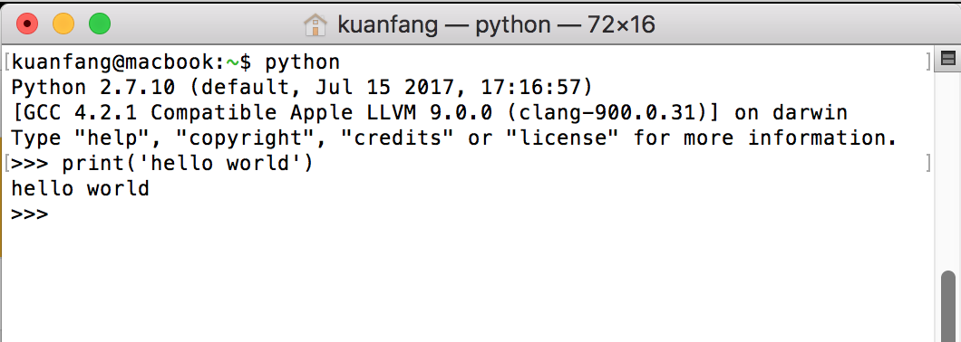
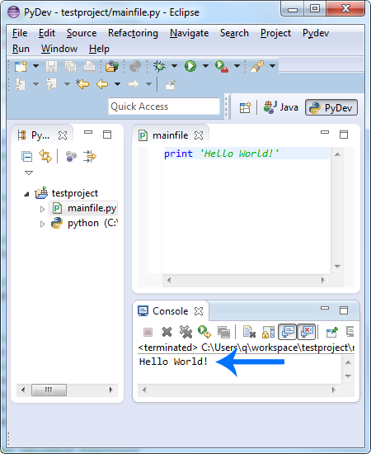
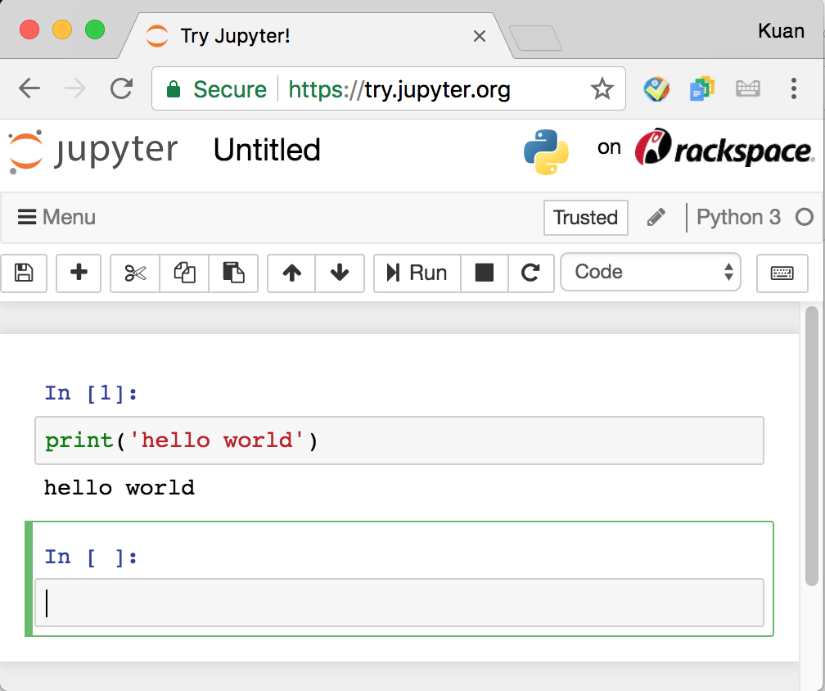
Why Python?
Python is accessible.
Interpreter/Terminal
IDE
Jupyter Notebook

Slide 7
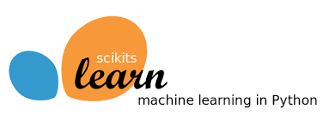

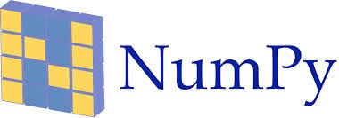

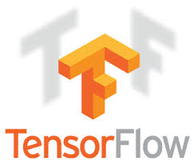


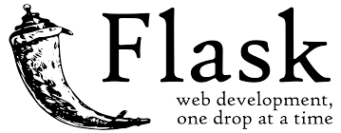



Why Python?
Python has many many awesome packages.

Slide 8
How to Set up Python?
Find a computer:
Your Linux/Mac/Windows/... machines.
Use Stanford Corn machines: https://web.stanford.edu/group/farmshare/cgi-bin/wiki/index.php/Main_Page
iMac computers in Stanford Libraries.
Follow this guide: https://wiki.python.org/moin/BeginnersGuide/Download
Choose your favourite editor or IDE:
Sublime
Notepad++
Vim
Spyder
PyCharm
Eclipse
Jupyter Notebook
...

Slide 9
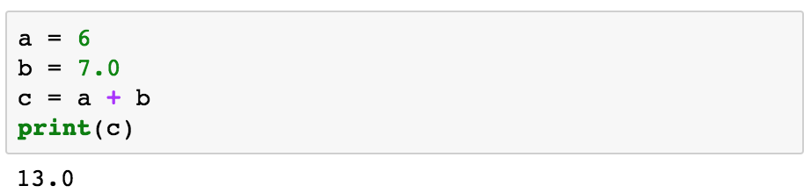
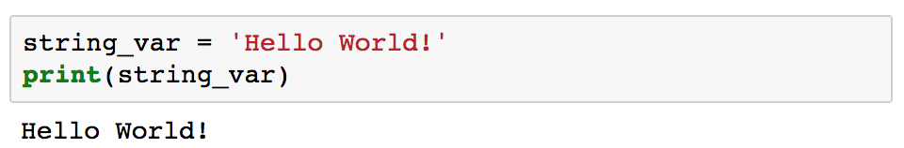
Variable

Slide 10
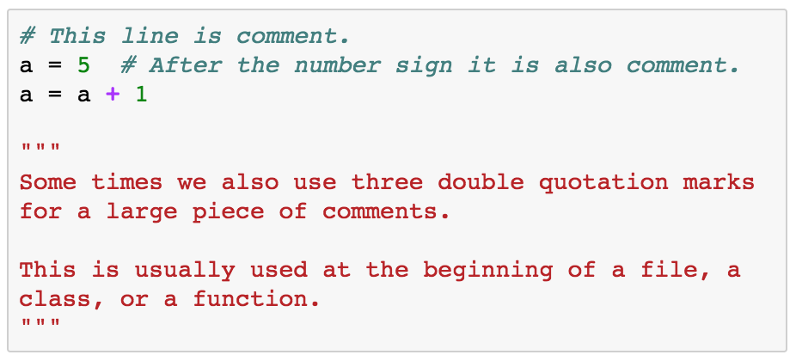
Comment

Slide 11
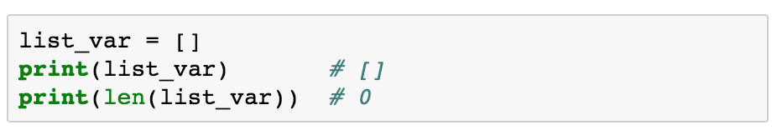
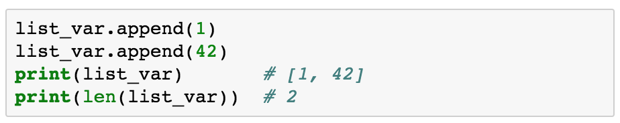
List
Notes:
Square Brackets

Slide 12
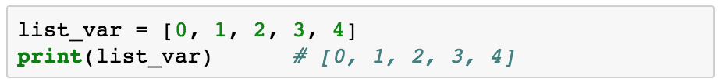
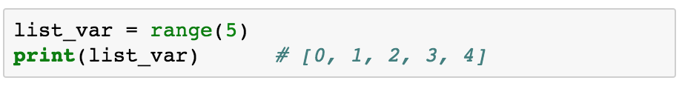
List

Slide 13
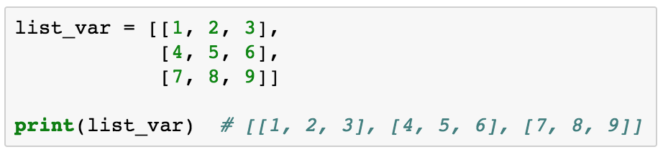
List

Slide 14
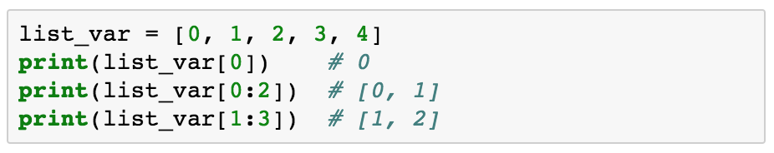
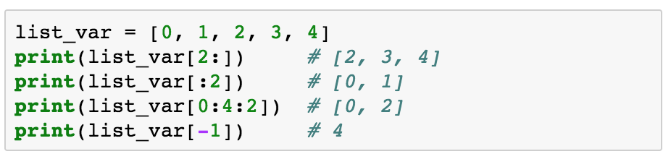
List Indexing

Slide 15
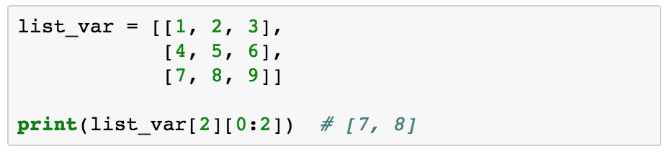
List Indexing

Slide 16
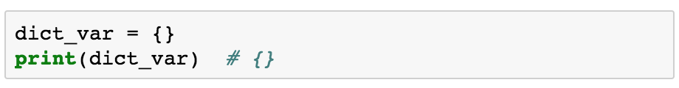
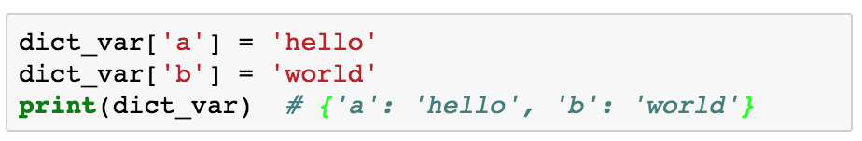
Dictionary (Similar to Map in Java/C++)
Notes:
Braces

Slide 17
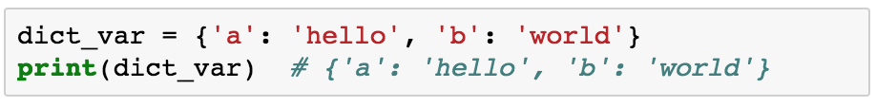
Dictionary

Slide 18
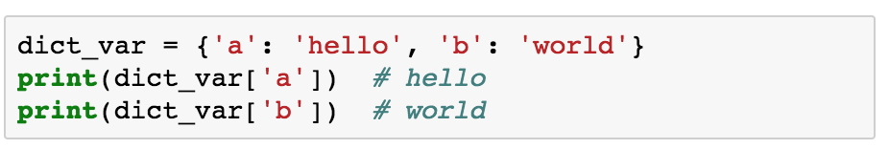
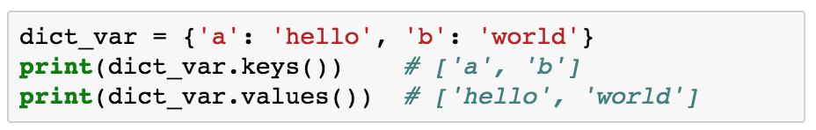
Dictionary Indexing

Slide 19
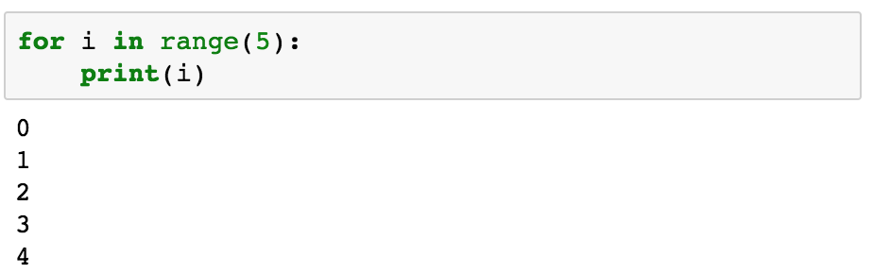
Control Flow

Slide 20
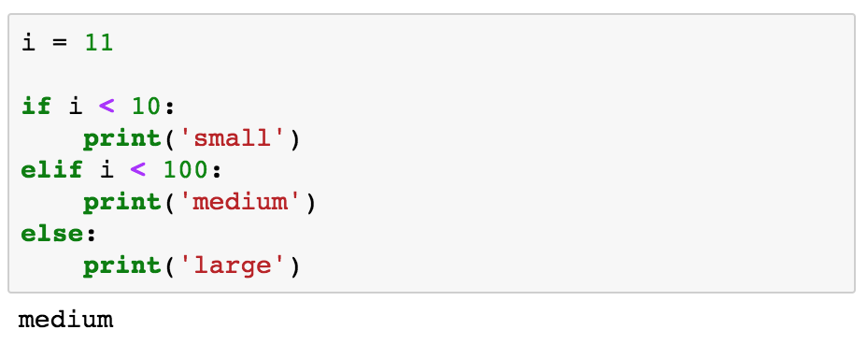
Control Flow

Slide 21
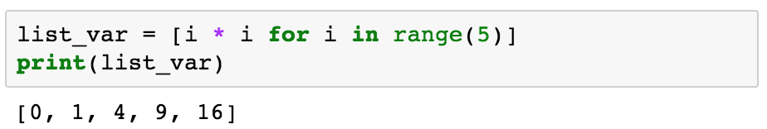
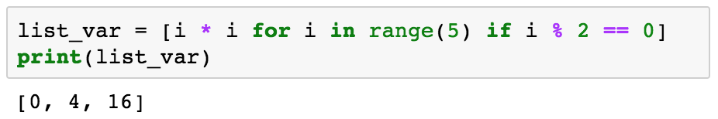
List Comprehension

Slide 22
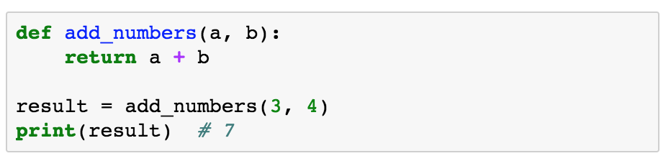
Function

Slide 23
Linear Algebra Review
+ Numpy

Slide 24
Why use Linear Algebra in Computer Vision?
As you’ve seen in lecture, it’s useful to represent many quantities, e.g. 3D points on a scene, 2D points on an image.
Transformations of 3D points with 2D points can be represented as matrices.
Images are literally matrices filled with numbers (as you will see in HW0).

Slide 25
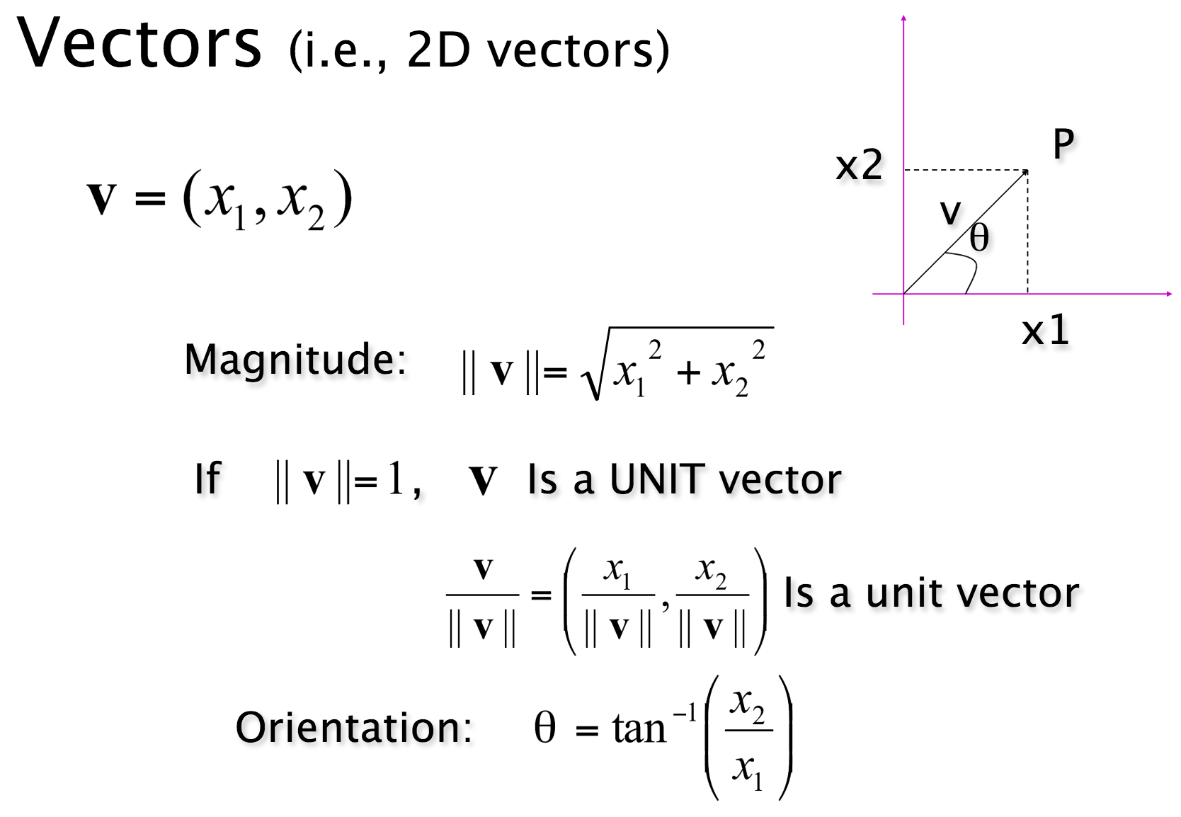
Vector Review
*Courtesy of last year’s slides.

Slide 26
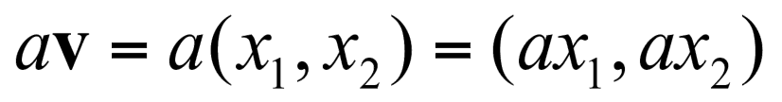
Vector Review
*Courtesy of last year’s slides.

Slide 27
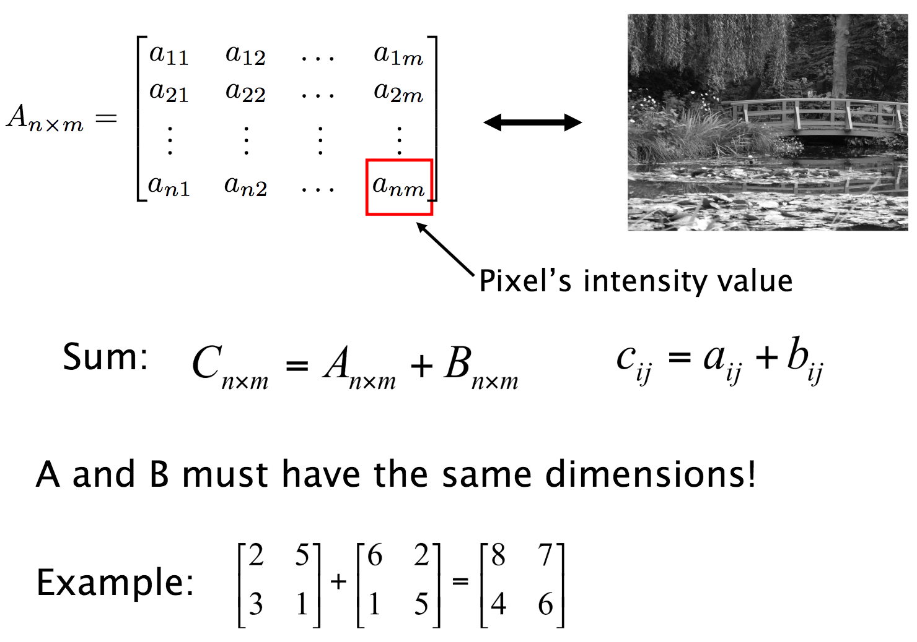
Matrix Review
*Courtesy of last year’s slides.

Slide 28

Matrices and Vectors in Python (NumPy)
import numpy as np
An optimized, well-maintained scientific computing package for Python.
As time goes on, you’ll learn to appreciate NumPy more and more.
Years later I’m still learning new things about it!

Slide 29

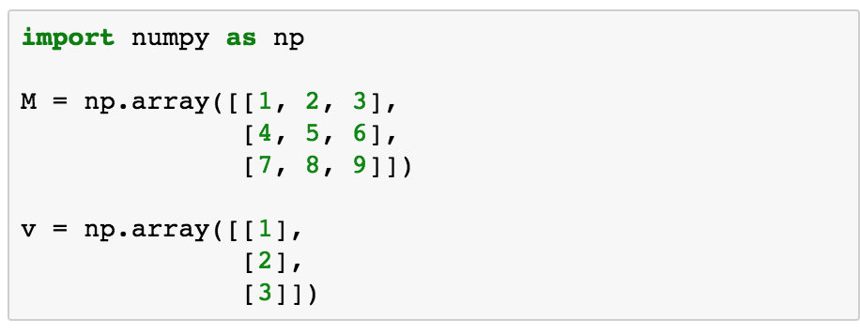
np.ndarray: Matrices and Vectors in Python

Slide 30
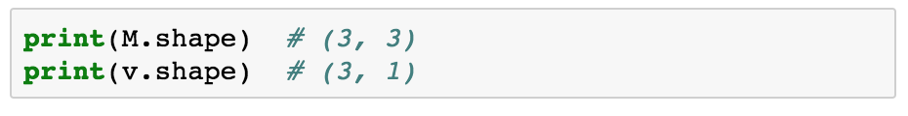
np.ndarray: Matrices and Vectors in Python

Slide 31
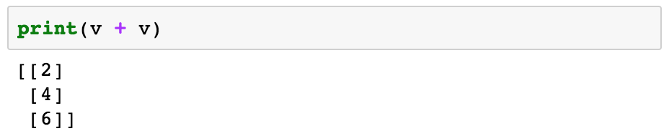
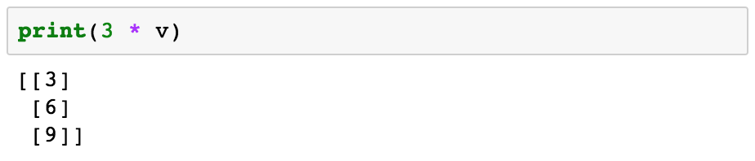
np.ndarray: Matrices and Vectors in Python

Slide 32
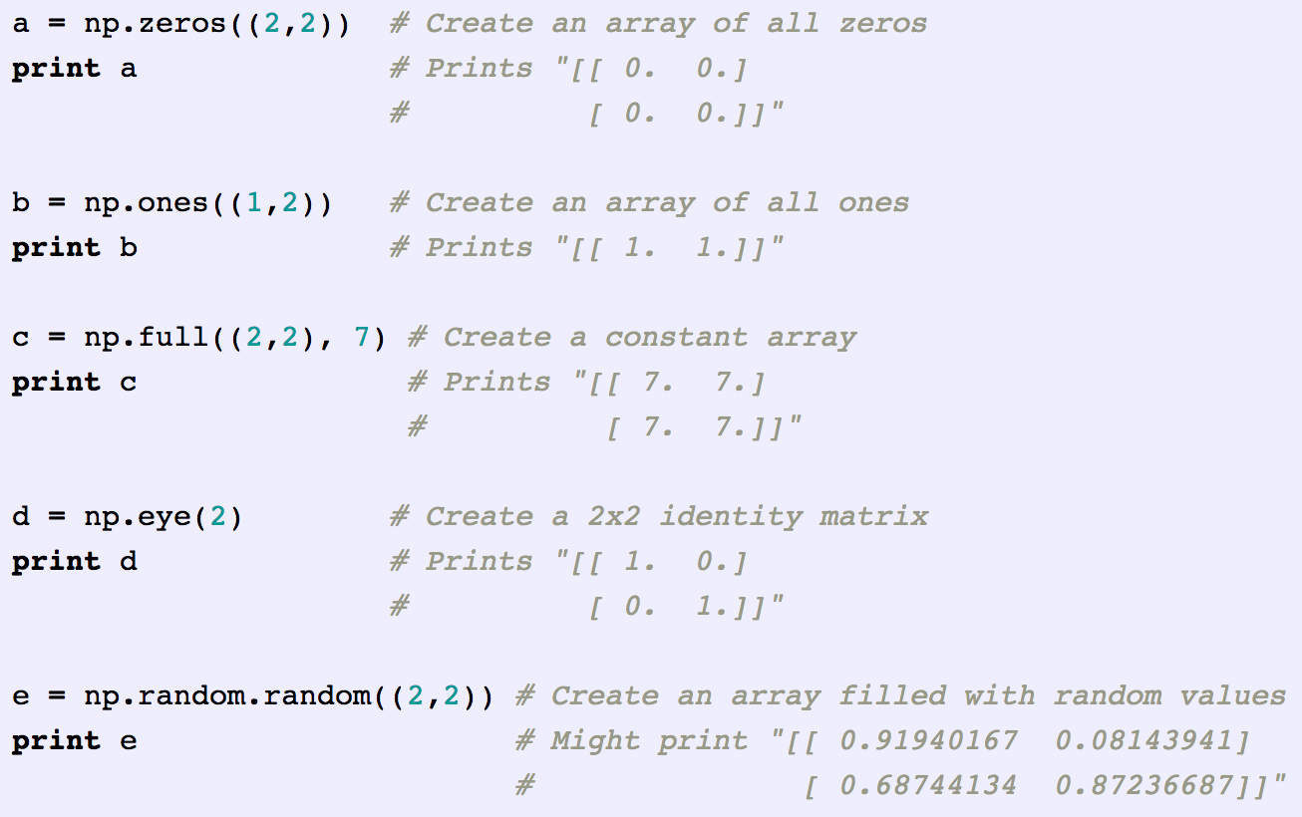
Other Ways to Create Matrices and Vectors
NumPy provides many convenience functions for creating matrices/vectors.

Slide 33
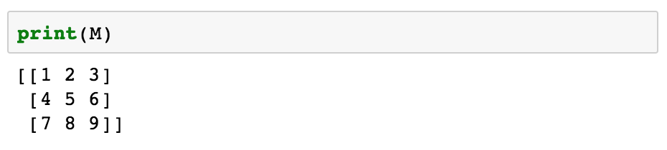
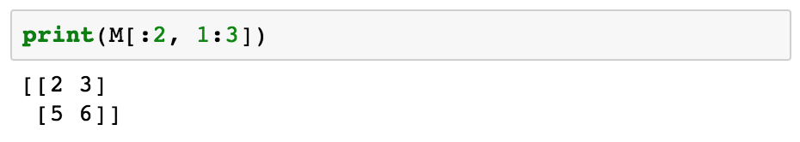
Matrix Indexing

Slide 34
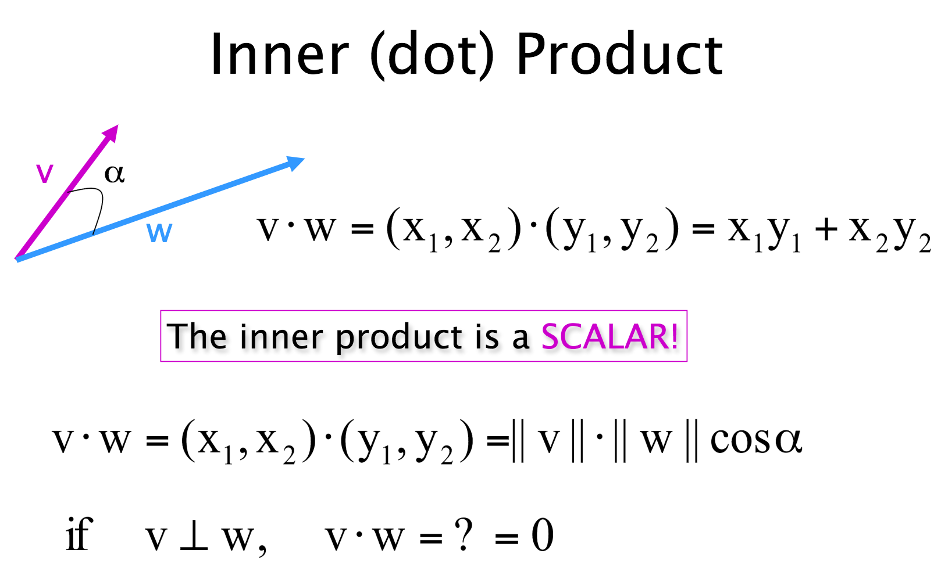
Dot Product
*Courtesy of last year’s slides.

Slide 35
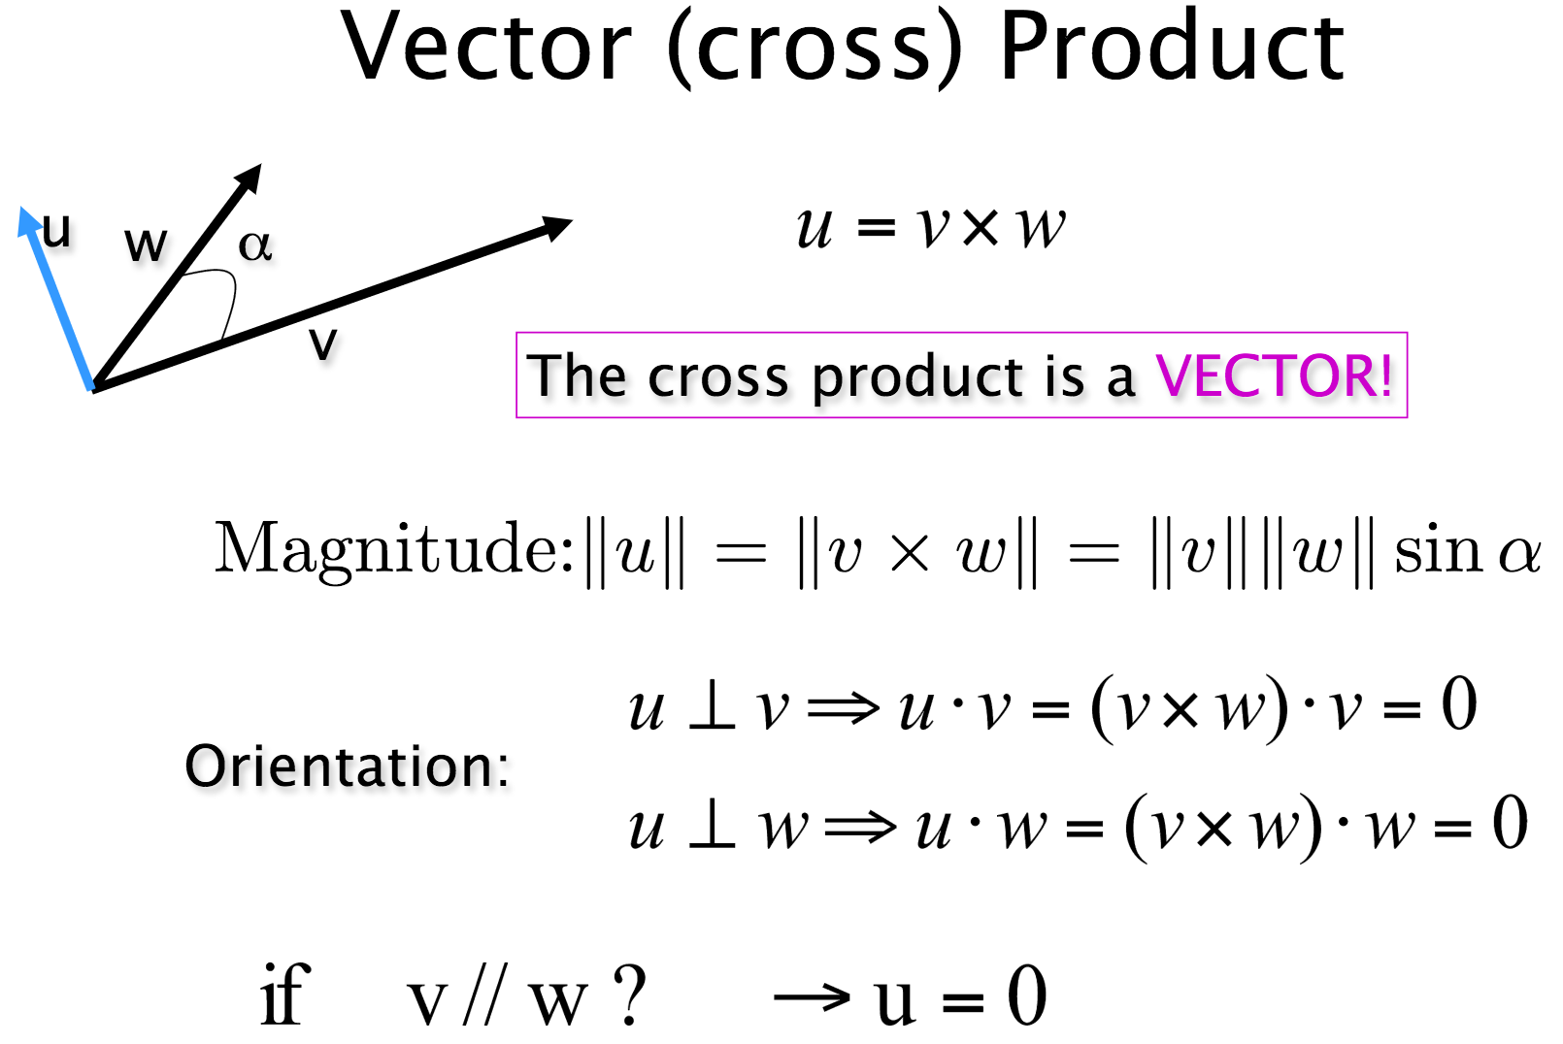
Cross Product
*Courtesy of last year’s slides.

Slide 36
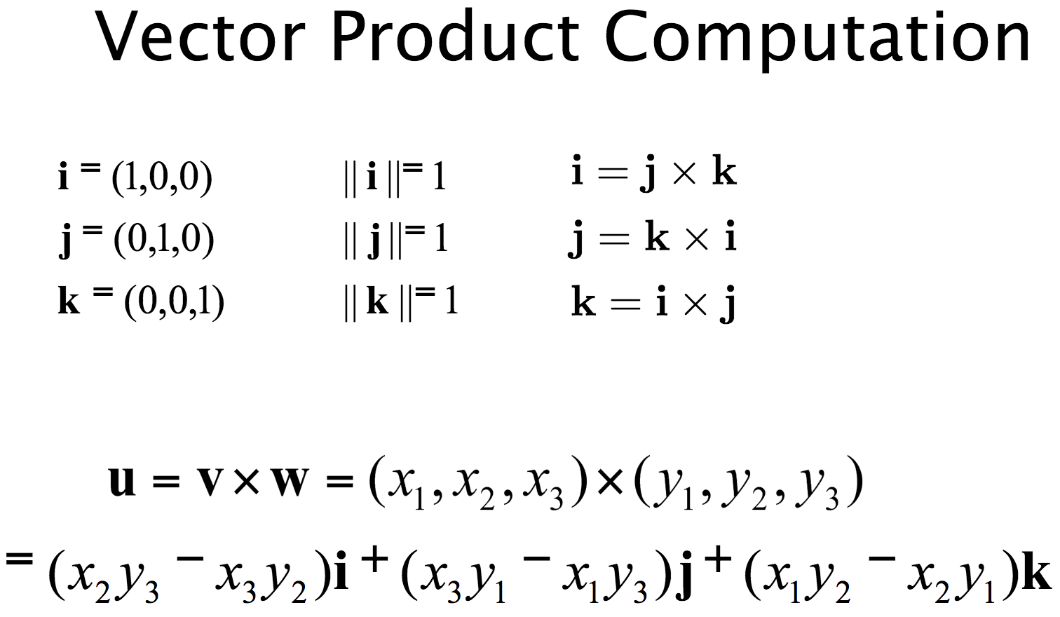
Cross Product
*Courtesy of last year’s slides.

Slide 37
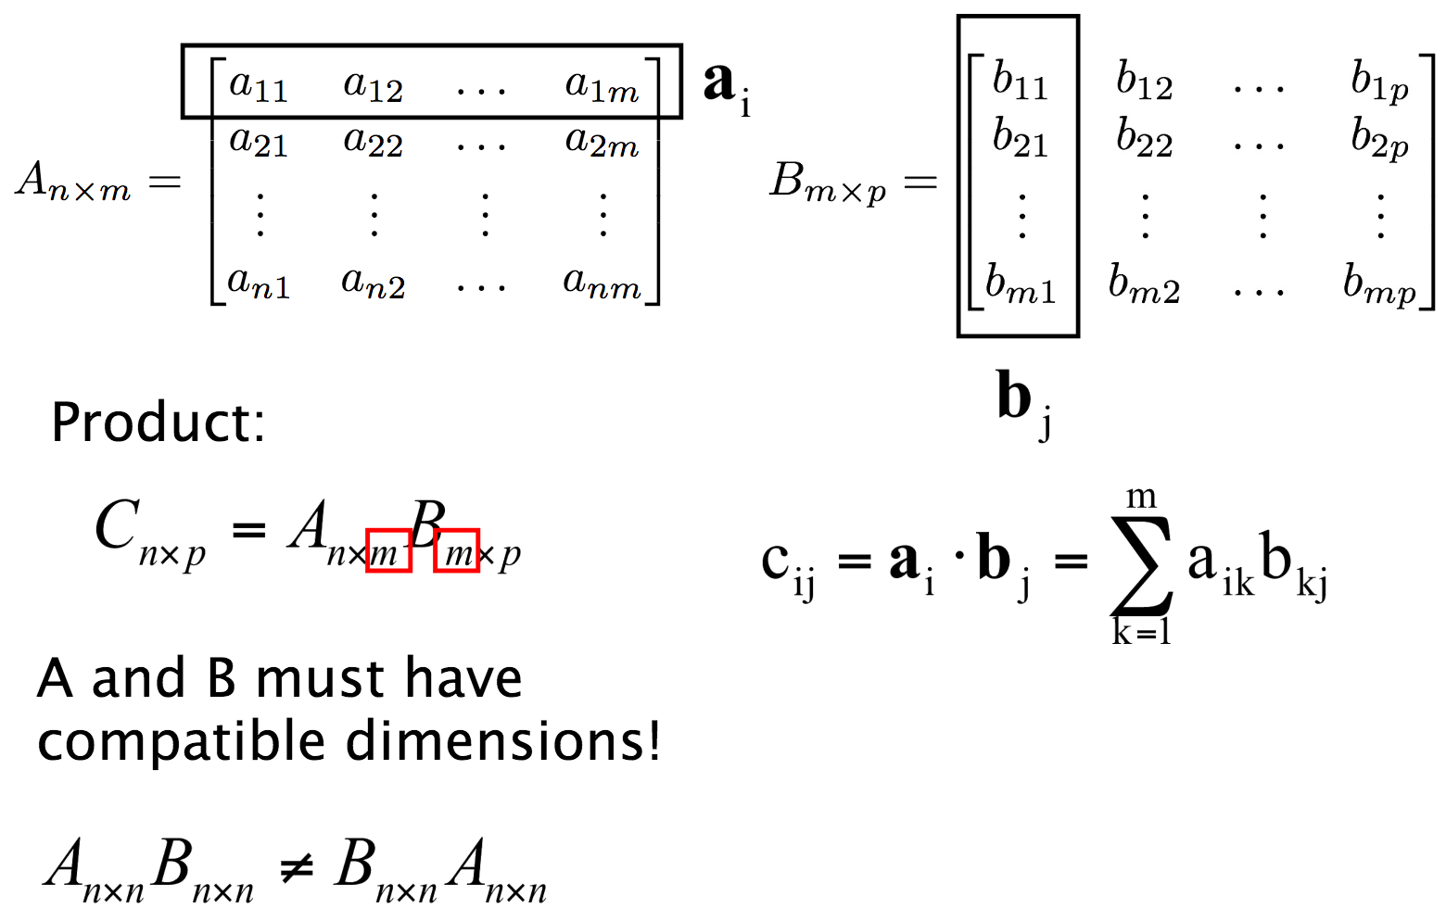
Matrix Multiplication
*Courtesy of last year’s slides.

Slide 38
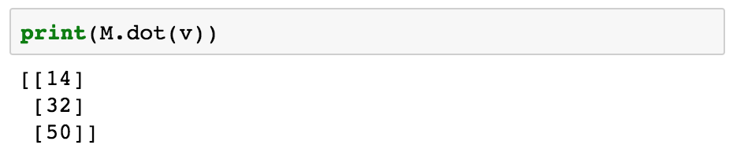
Basic Operations - Dot Multiplication
Matrix multiplication in NumPy can be defined as the dot product between a matrix and a matrix/vector.

Slide 39
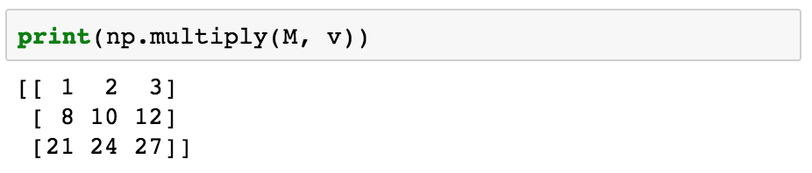
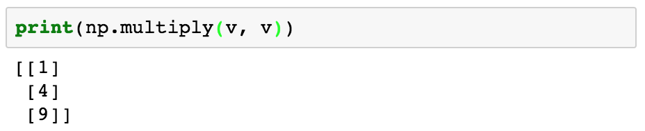
Basic Operations - Element-wise Multiplication

Slide 40
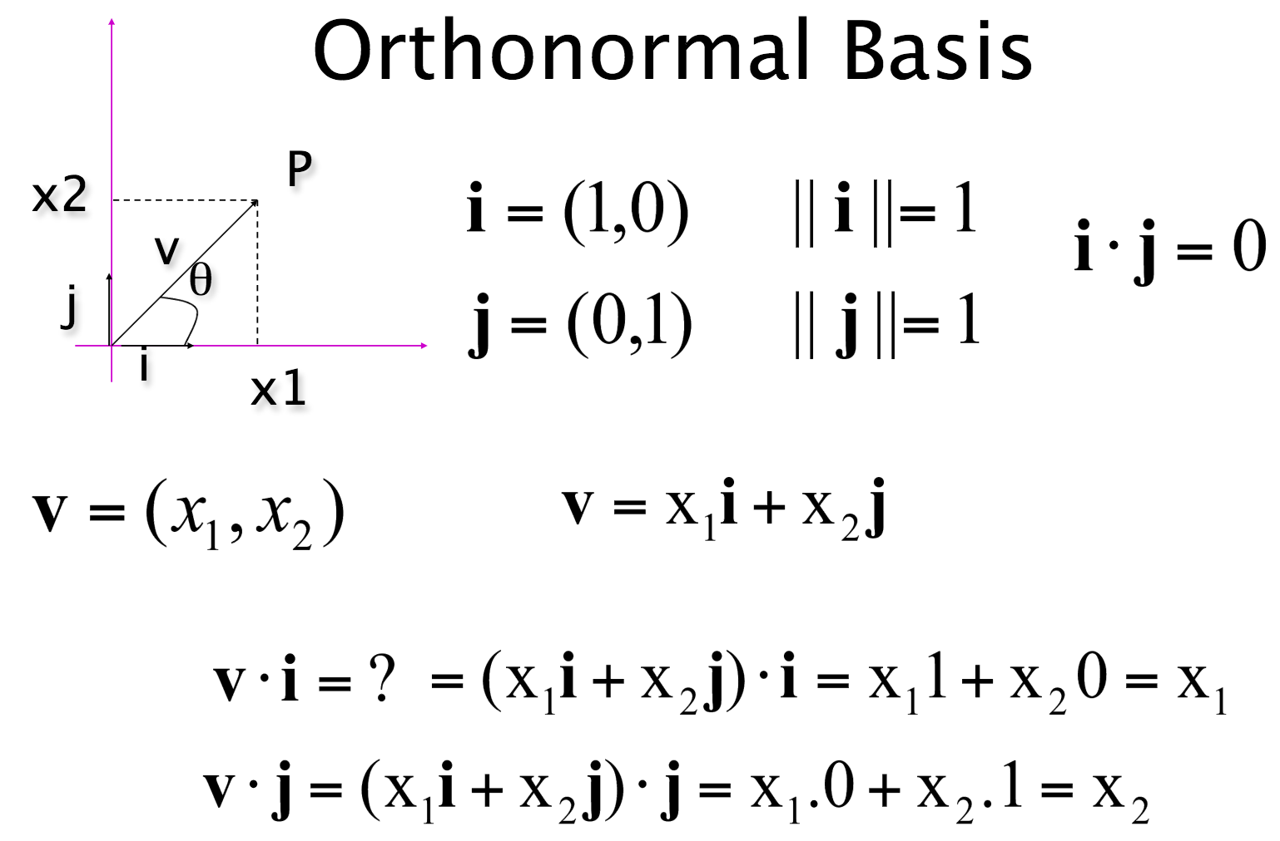
Orthonormal Basis
= Orthogonal and Normalized Basis
*Courtesy of last year’s slides.

Slide 41
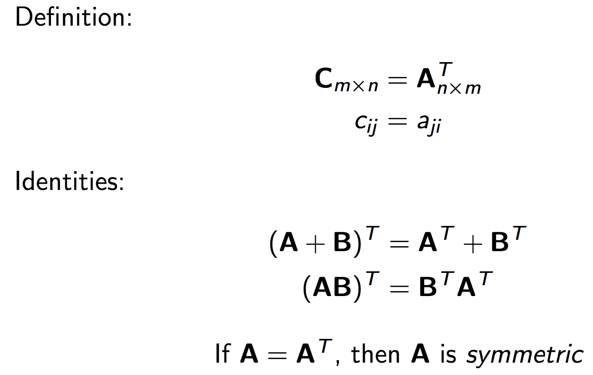
Transpose
*Courtesy of last year’s slides.

Slide 42
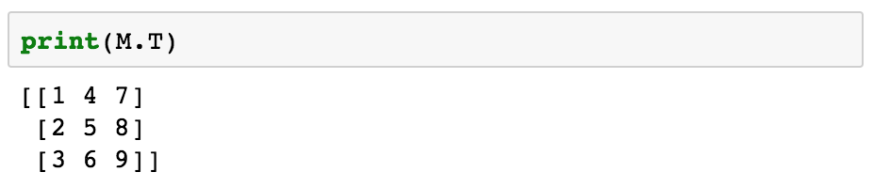
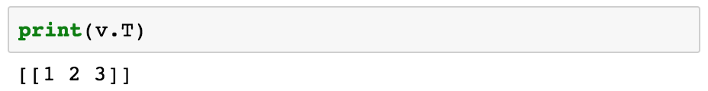

Basic Operations - Transpose

Slide 43

Matrix Determinant
*Courtesy of last year’s slides.

Slide 44

Matrix Inverse
*Courtesy of last year’s slides.

Slide 45



Basic Operations - Determinant and Inverse

Slide 46

Matrix Eigenvalues and Eigenvectors
*Courtesy of last year’s slides.

Slide 47

Matrix Eigenvalues and Eigenvectors
*Courtesy of last year’s slides.

Slide 48


Basic Operations - Eigenvalues, Eigenvectors
NOTE: Please read the NumPy docs on this function before using it, lots more information about multiplicity of eigenvalues and etc there.

Slide 49

Singular Value Decomposition
*Courtesy of last year’s slides.

Slide 50

Singular Value Decomposition
*Courtesy of last year’s slides.

Slide 51

Singular Value Decomposition
Recall SVD is the factorization of a matrix into the product of 3 matrices, and is formulated like so:
M = UΣV^{T}
Caution: The notation of SVD in NumPy is slightly different. Here V is actually V^{T} in the common notation.

Slide 52


More Information
Python Documentation: https://docs.python.org/2/index.html
NumPy Documentation: https://docs.scipy.org/doc/numpy-1.13.0/user/index.html
The Matrix Cookbook: https://www.math.uwaterloo.ca/~hwolkowi/matrixcookbook.pdf
CS231N Python Tutorial: http://cs231n.github.io/python-numpy-tutorial/
Office hours!
The rest of the internet!

Slide 53
Thanks!
Questions

